Slide 1

2020 Company Strategy
Rockbuster Stealth LLC
Kara Evans, July 2023

Slide 2
A new era: online video streaming services
Rockbuster is launching an online video rental service to stay current with evolving technologies.
This presentation will identify:
Geographical markets to promote Rockbuster’s brand
Popular films and their revenue
Rockbuster’s most loyal customers
Key Questions:
What was the average rental duration for all videos?
Which movies contributed the most/least to revenue gain?
Which countries are Rockbuster customers based in?
Do sales figures vary between geographic regions?
Where are customers with a high lifetime value based?

Slide 3

Addressing the data
Business metrics
Average rental time and cost per day
Most popular films in Rockbuster’s inventory
Highest and lowest earning ratings and film titles
Customer data
Countries with largest customer presence
Revenue by region
Locations of customers with highest total amount paid and most number of rentals

Slide 4
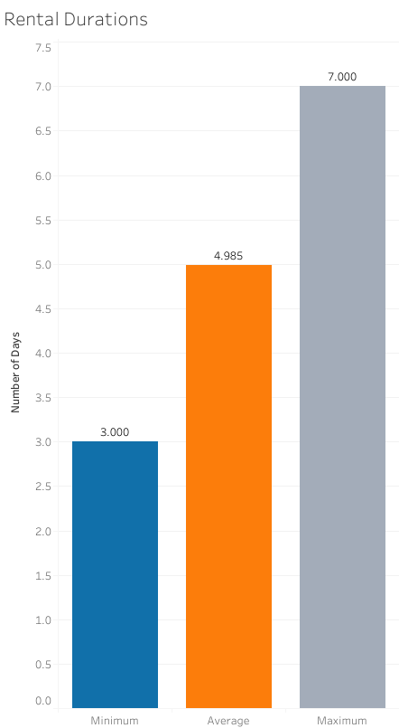
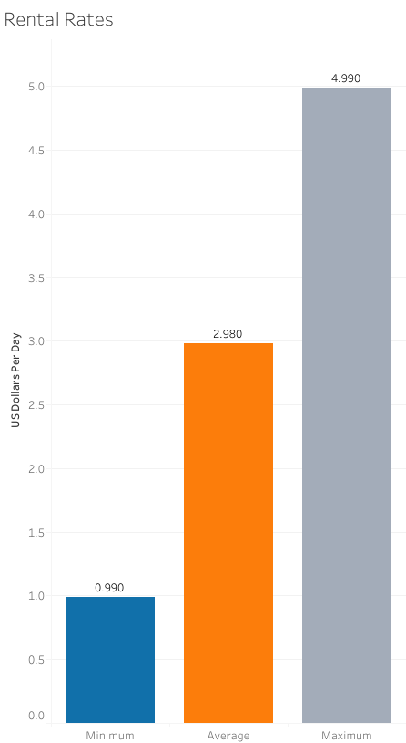
Rental duration & rates
The average rental time was just under 5 days and the average rental rate was $2.98 per rental.
Which film ratings are the most popular in Rockbuster’s inventory? And which rating brings in the most revenue?

Slide 5
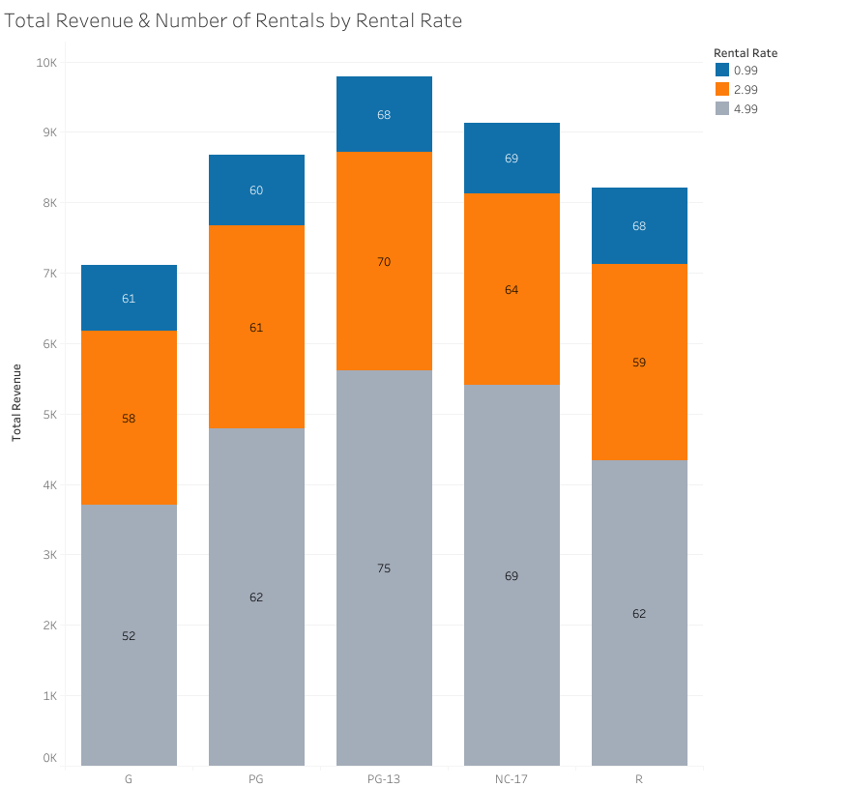
Film ratings & revenue
Rental identification numbers were used to count how often a film was rented.
PG-13 films generated the most revenue and had the highest count of rentals.
PG-13 films were also found to have the highest rental rates among other films.
Which film titles earned the highest revenue?

Slide 6
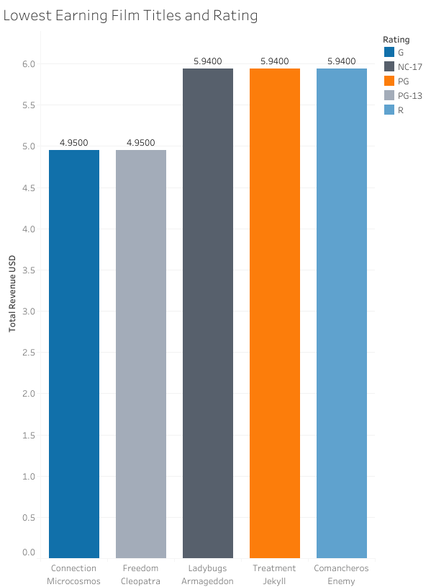
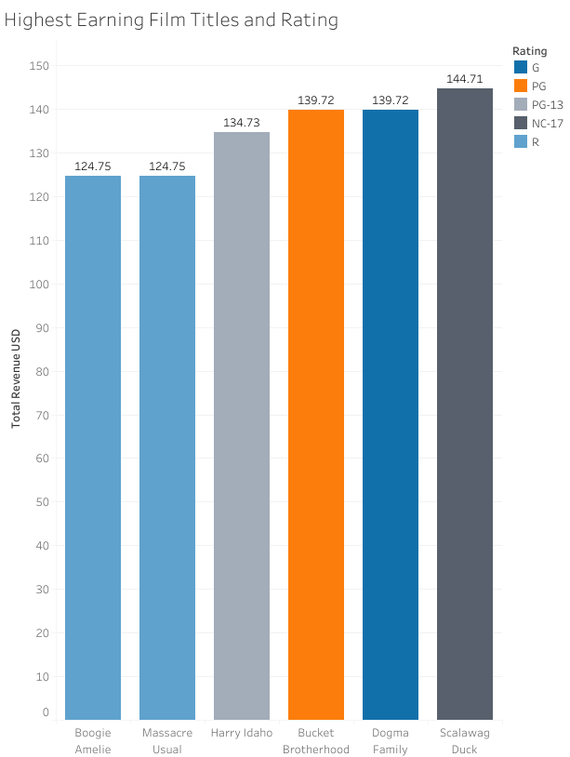
Total revenue by film title
Highest earning:
“Scalawag Duck”, rated NC-17
Lowest earning:
“Connection Microcosmos”, rated G
“Freedom Cleopatra”, rated PG-13
These results support the finding that PG-13 films are rented more frequently at a higher rental rate than other films.
Next, we will explore where Rockbuster’s customers are located throughout the world.

Slide 7
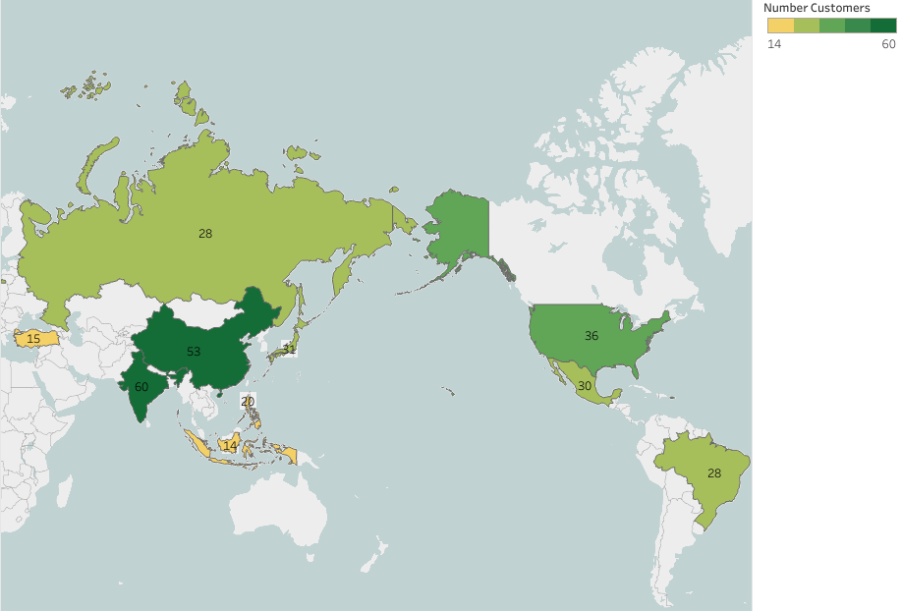
Top 10 countries
Customer identification numbers were used to calculate the total amount of customers in each country around the world.
These results were narrowed down to the top 10 countries with the largest customer presence:
India (60)
China (53)
USA (36)
Japan (31)
Mexico (30)
Russia (28)
Brazil (28)
Philippines (20)
Turkey (15)
Indonesia (14)

Slide 8
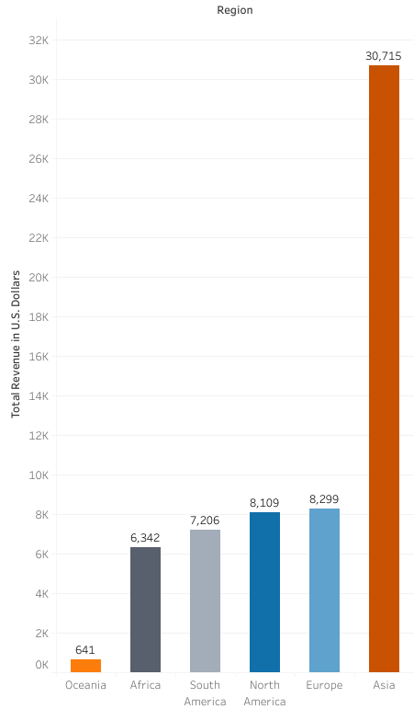
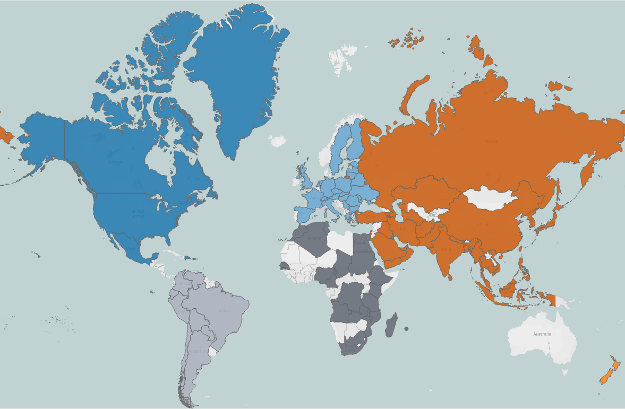
Revenue by Region
Seven of the ten countries with the largest customer populations are in Asia. This includes India which has the most customers overall.
Asia also has a significantly higher total revenue than other regions in the world.
Are Rockbuster’s top customers located in one of these countries?

Slide 9
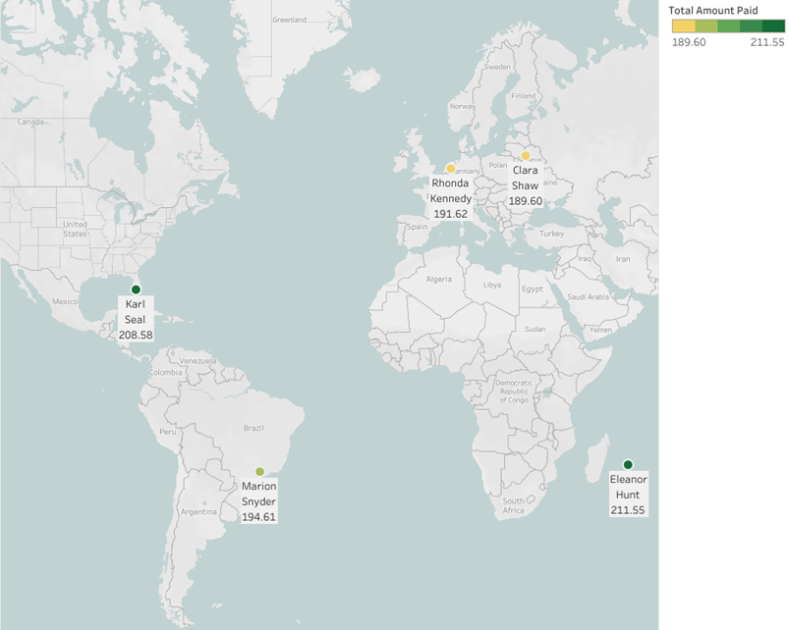
Top cities
Customers located within the top ten countries were counted by city to determine if any cities held a high number of customers.
Aurora, USA was found to have the most customers (2). However, the remaining cities only had one customer. These cities do not represent areas with a large customer base.
Top customers were searched by total amount spent and total rentals regardless of city or country.

Slide 10
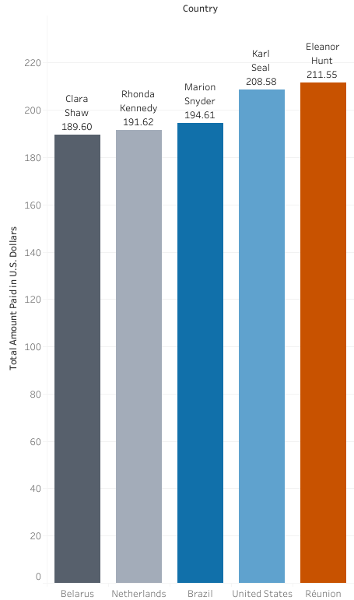
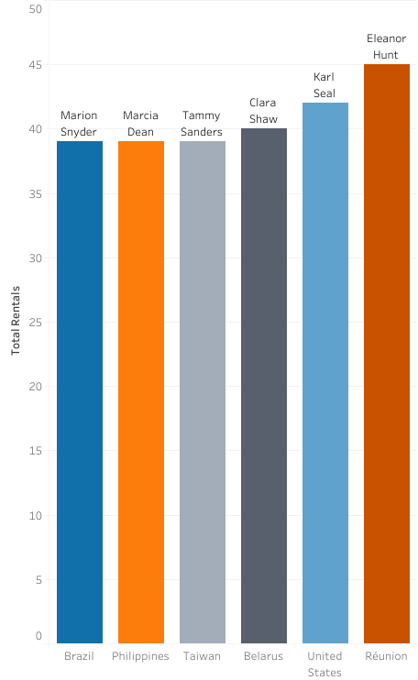
Top customers
Four customers were found on both lists:
Eleanor Hunt, Réunion
Karl Seal, USA
Marion Snyder, Brazil
Clara Shaw, Belarus
These customers have a high lifetime value based on their spending and rental frequency.
Two of the four customers are also based in the top 10 countries (USA & Brazil).

Slide 11
Conclusions & Recommendations
Conclusions:
Asia has the largest customer base and revenue stream.
Films rated PG-13 are the most popular and generate the largest total revenue.
Top customers were discovered based on metrics that generate revenue for the company (rental frequency and total spending).
Recommendations:
Focus brand image in Asian markets.
Consider adding length of membership as a metric for measuring customer loyalty.
Collect additional customer data (age, language, movie rental genres, etc.) to better understand customer behavior.
Update film inventory based on customer demographics and rental data to meet demand.

Slide 12
Questions?
Please send comments and questions to:
Kara Evans
Kara.e177409@gmail.com
Visualizations: Rockbuster 2020 Company Strategy

